Slide 1
Portfolio
Website
By Jade Tyrer

Slide 2
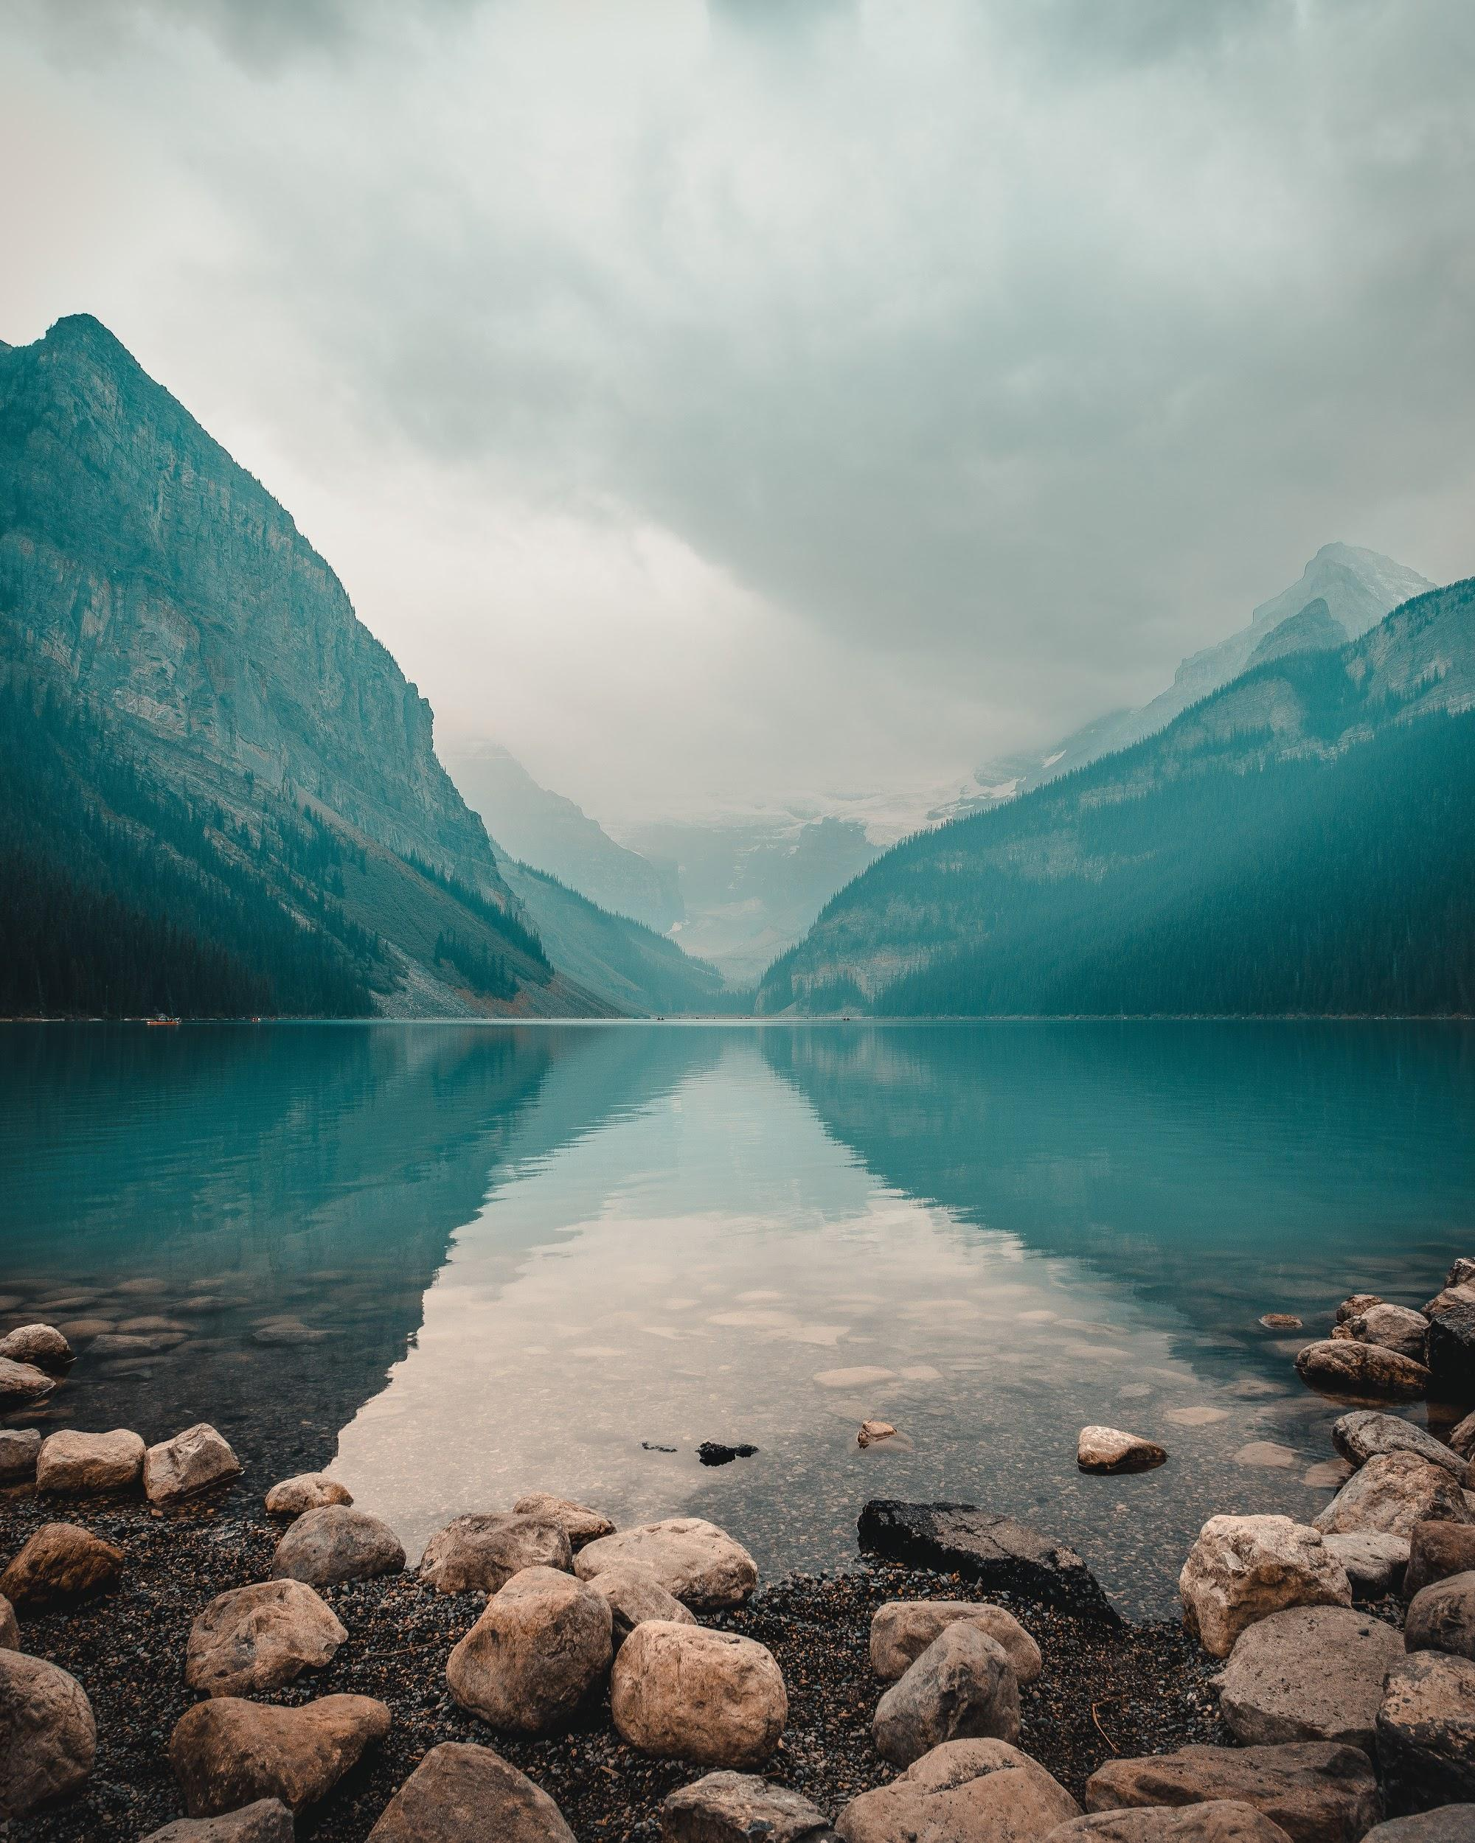
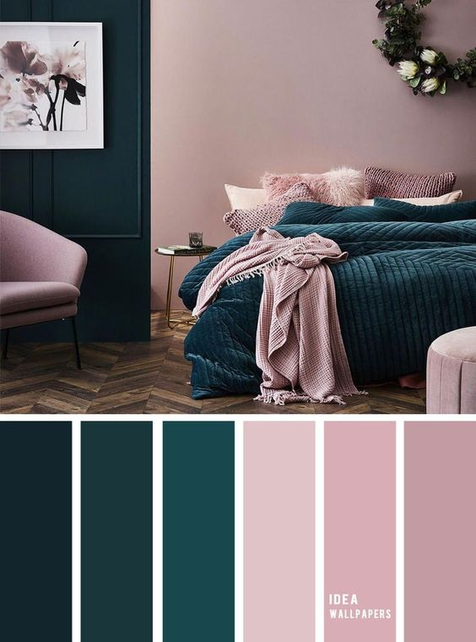
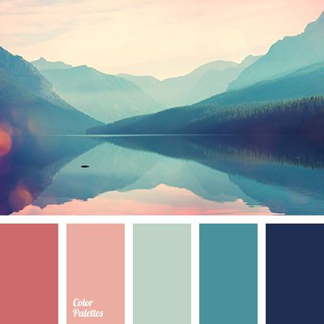
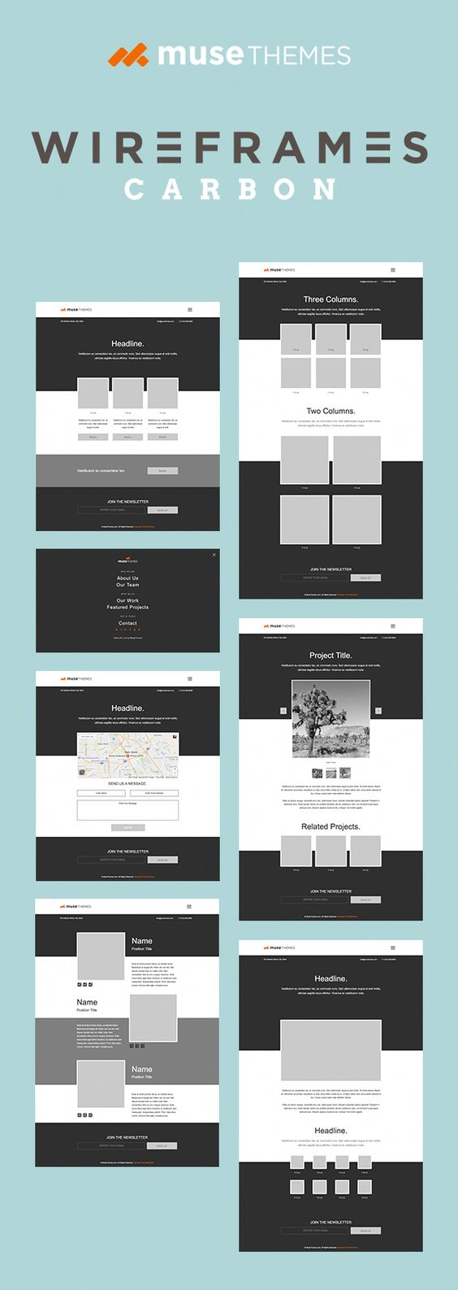
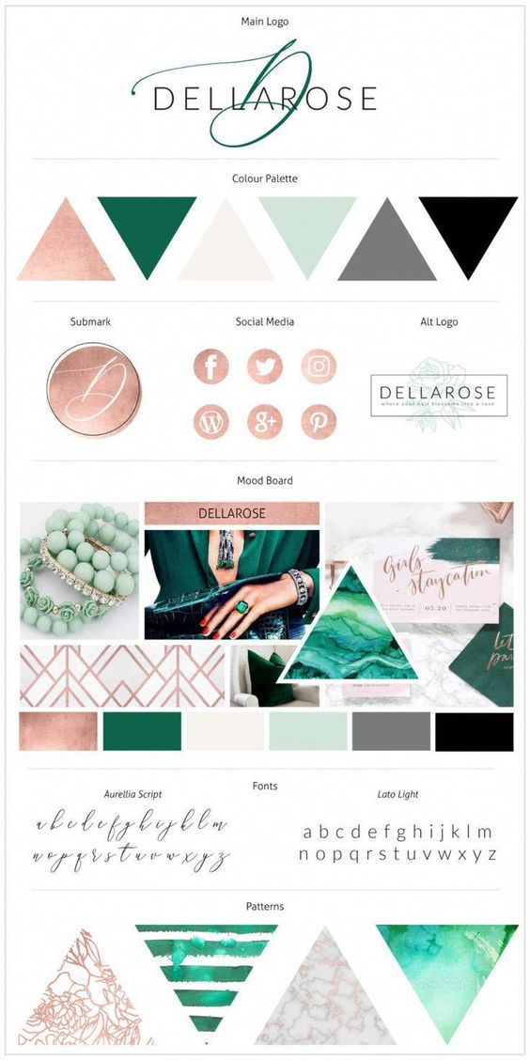
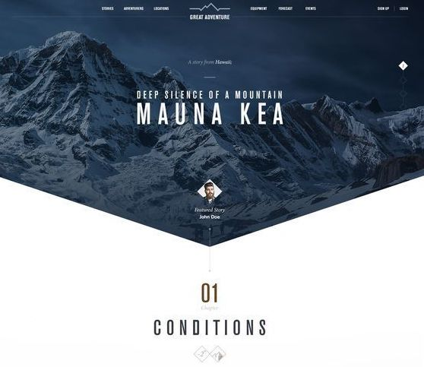
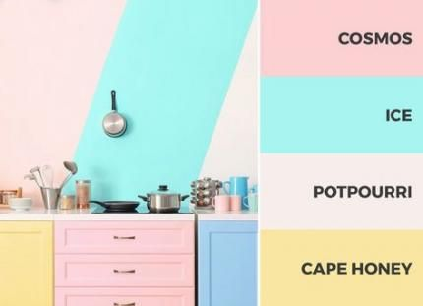
Moodboard.
Notes:
Pintrest
Colour palette ideas
Examples of wireframes
Website design inspiration

Slide 3
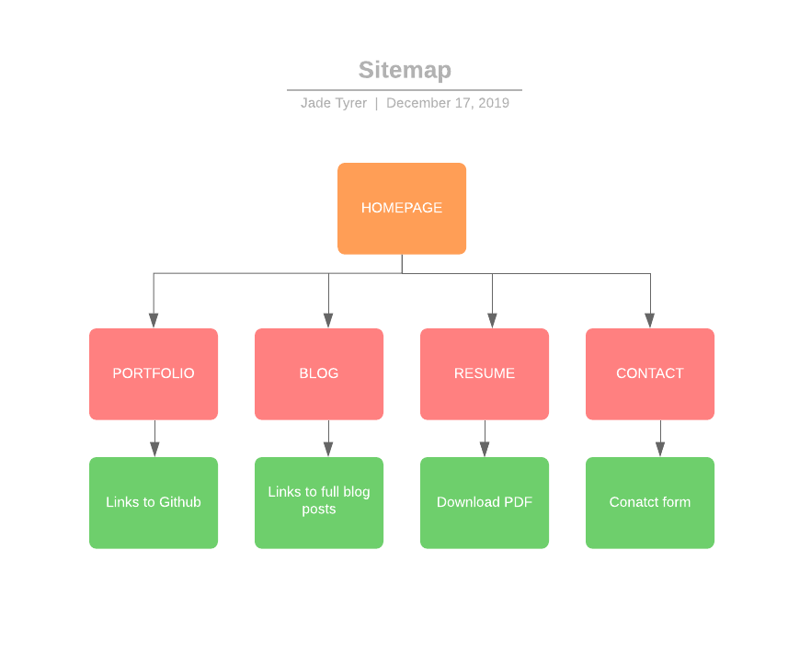
Sitemap.
Notes:
Homepage plus 4 pages

Slide 4
Components.
Nav-bar
Burger menu
Blog list
Footer
Components.
Notes:
Head and Footer
Burger menu
Changes to shapes
Decided to go with mountain background as the page looked quite bare without an image behind (I used to live in the mountains)
Polygon header shape to create a unique look and engage user
Picture goes well with the background image
Not sure why the image took this way I will show you it doesnt look like that
Different shapes for contrast to symetrical header

Slide 5
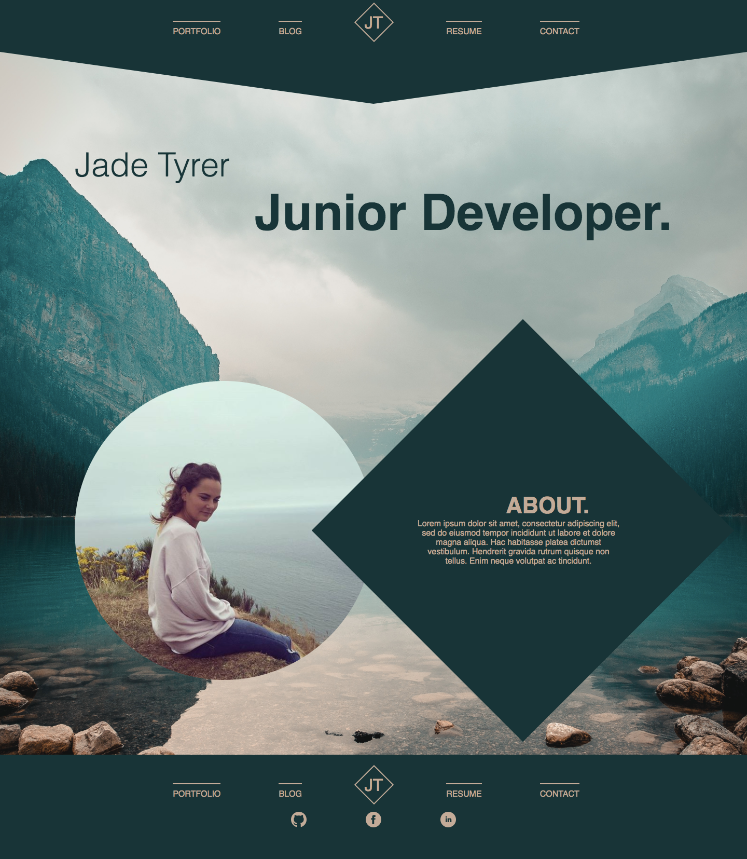
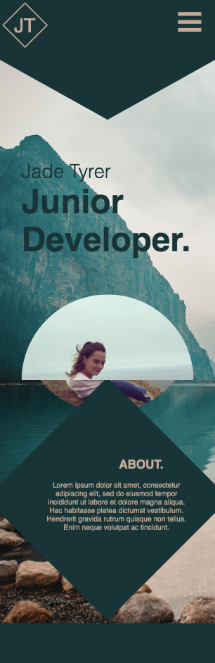
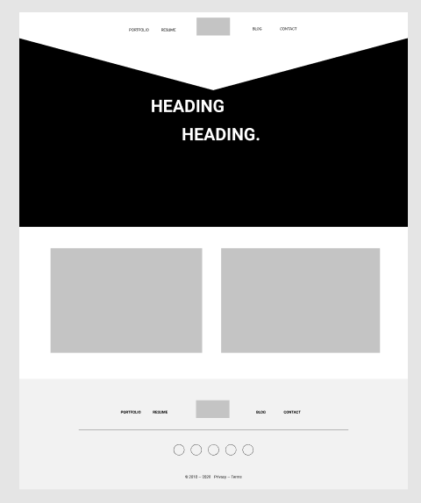
Homepage.
Notes:
Head and Footer
Burger menu
Changes to shapes
Decided to go with mountain background as the page looked quite bare without an image behind (I used to live in the mountains)
Polygon header shape to create a unique look and engage user
Picture goes well with the background image
Not sure why the image took this way I will show you it doesnt look like that
Different shapes for contrast to symetrical header

Slide 6
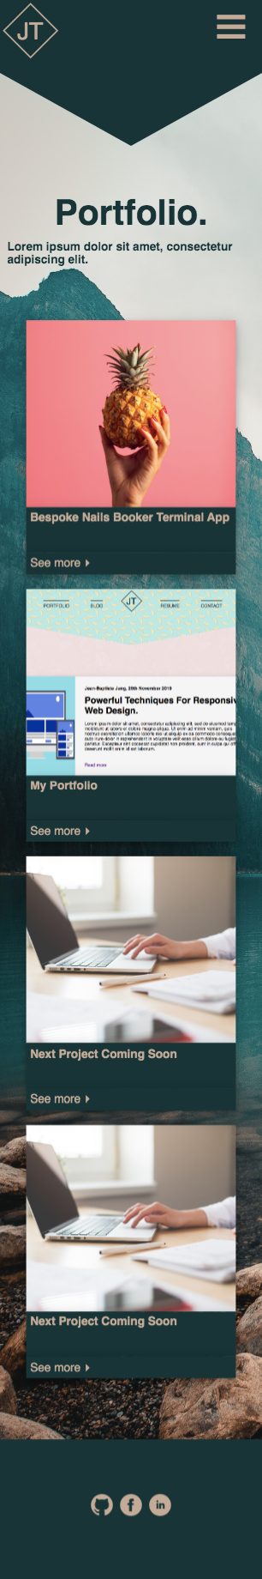
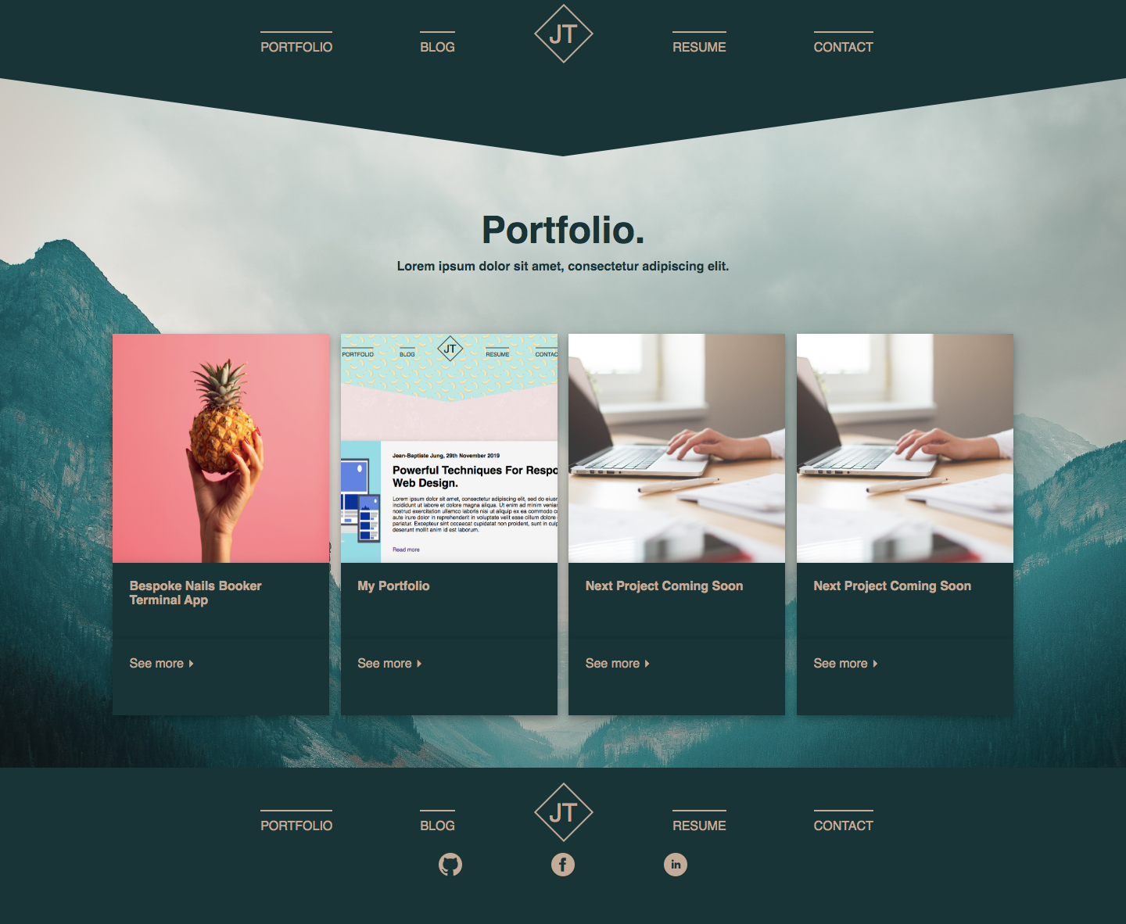
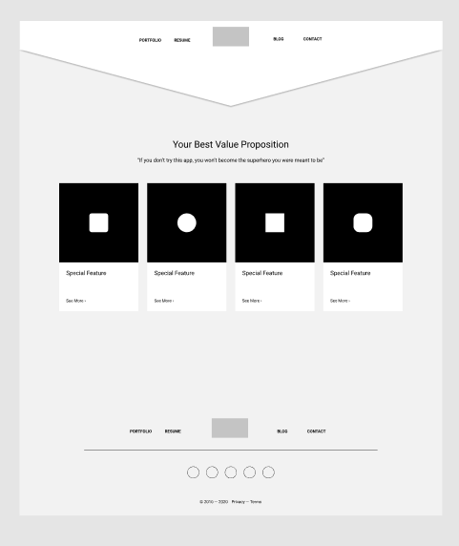
Portfolio.
Notes:
Grid layout
Rearragne order of grid items

Slide 7
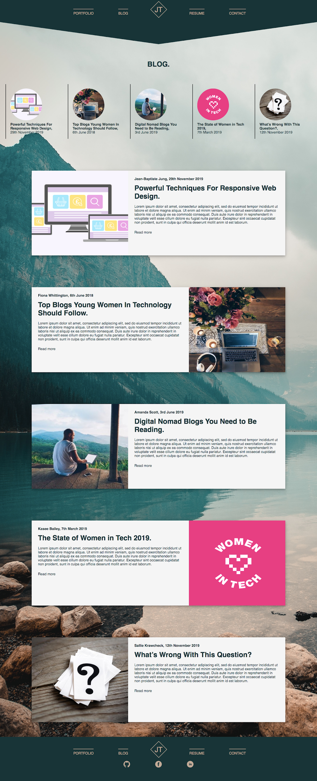
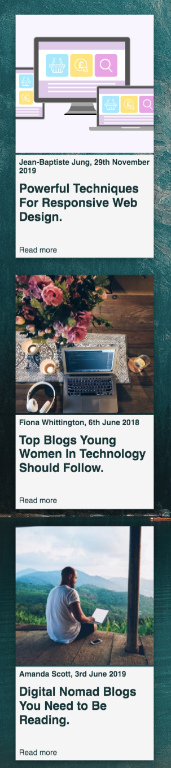
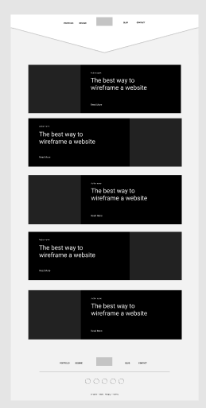
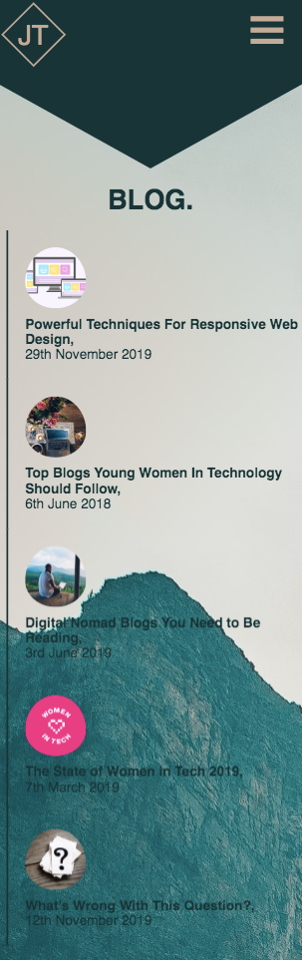
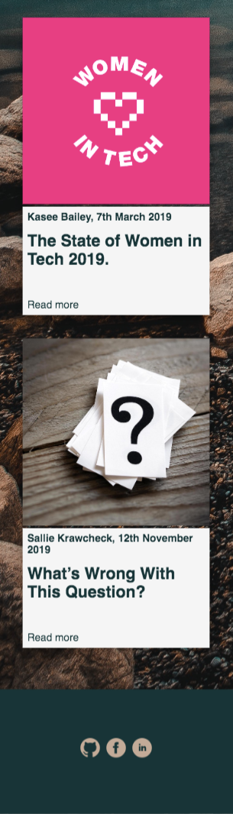
Blog.
Notes:
Flex box - same boxes
Reverse property
Anchored list to jump to right part of page

Slide 8
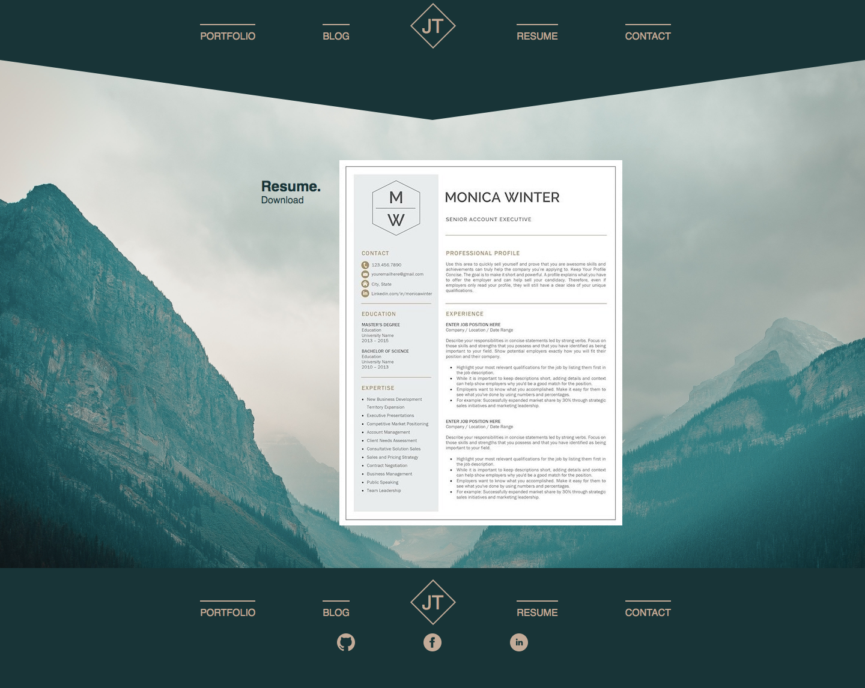
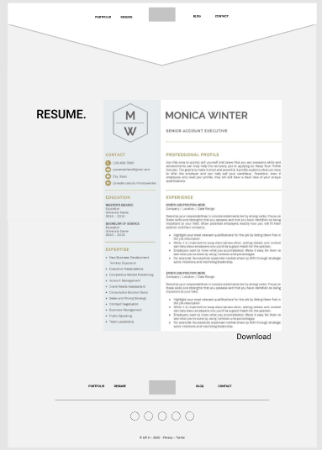
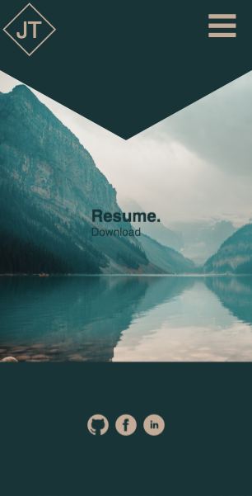
Resume.
Notes:
Displays resume on page - more likely to look at it
Download pdf

Slide 9
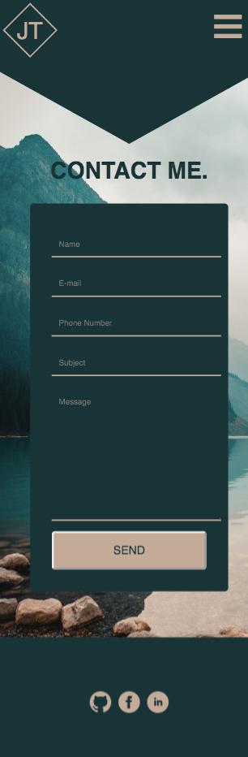
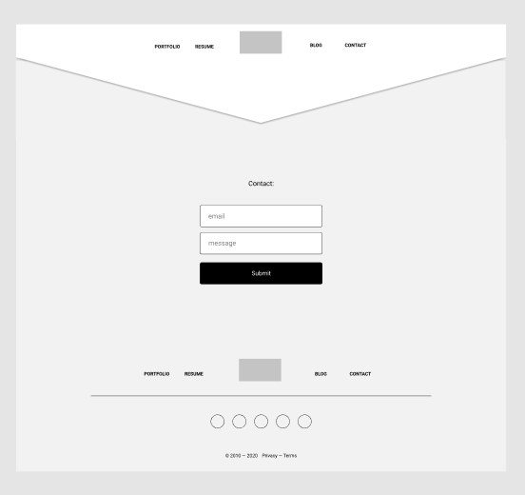
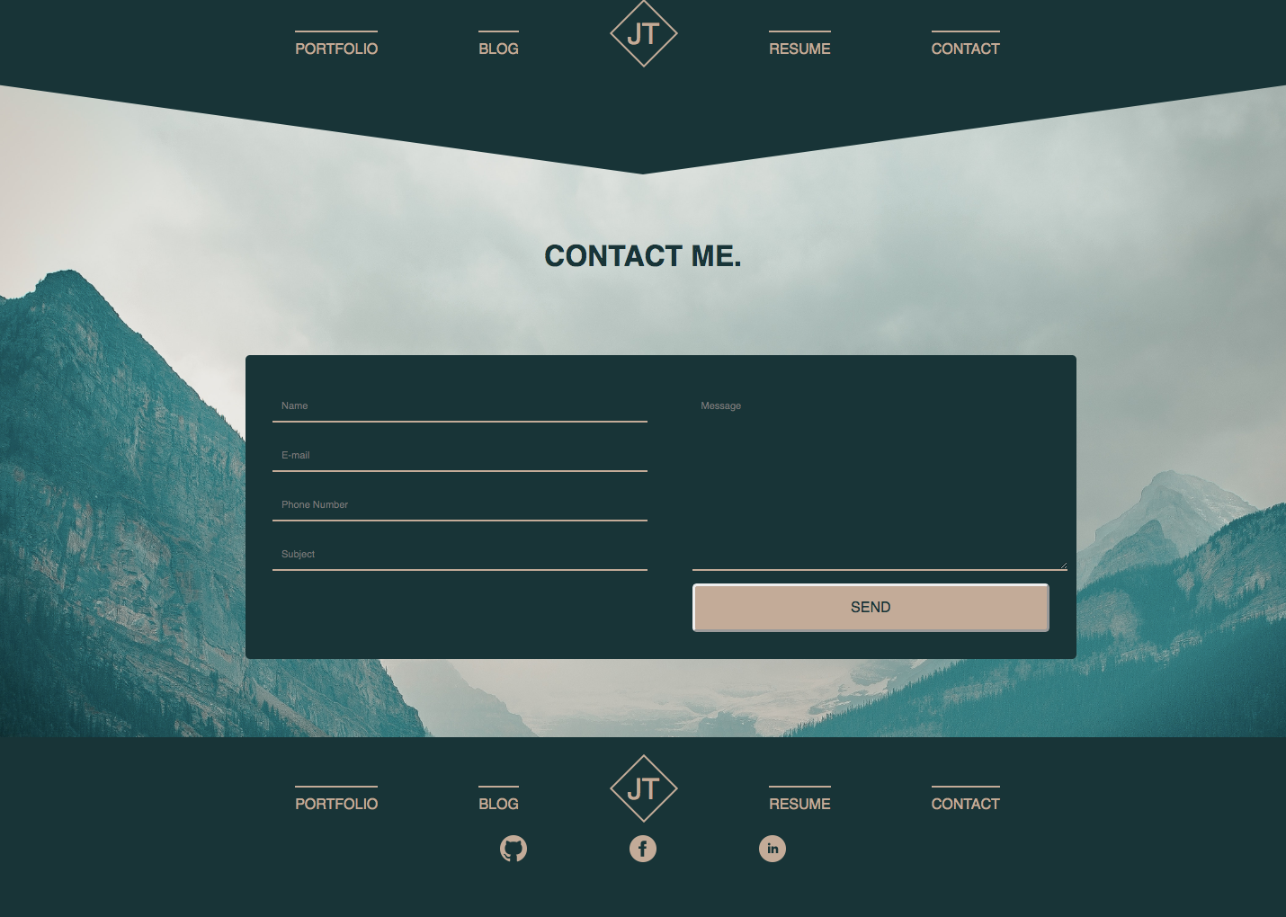
Contact.
Notes:
Flexbox wraps when on mobile view
Changed from initial wireframe

Slide 10
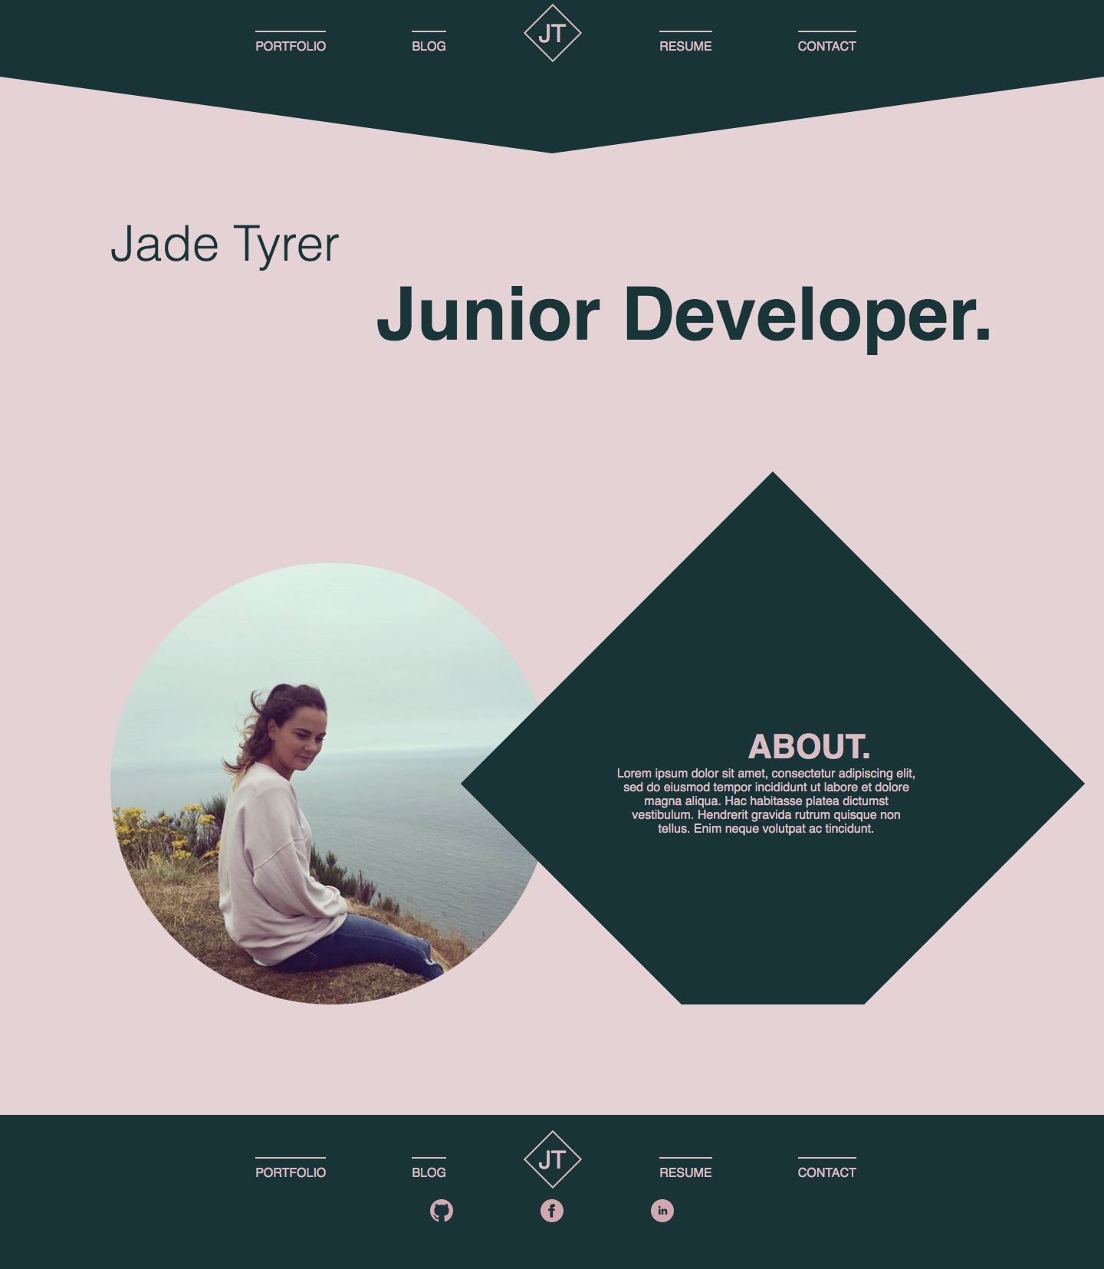
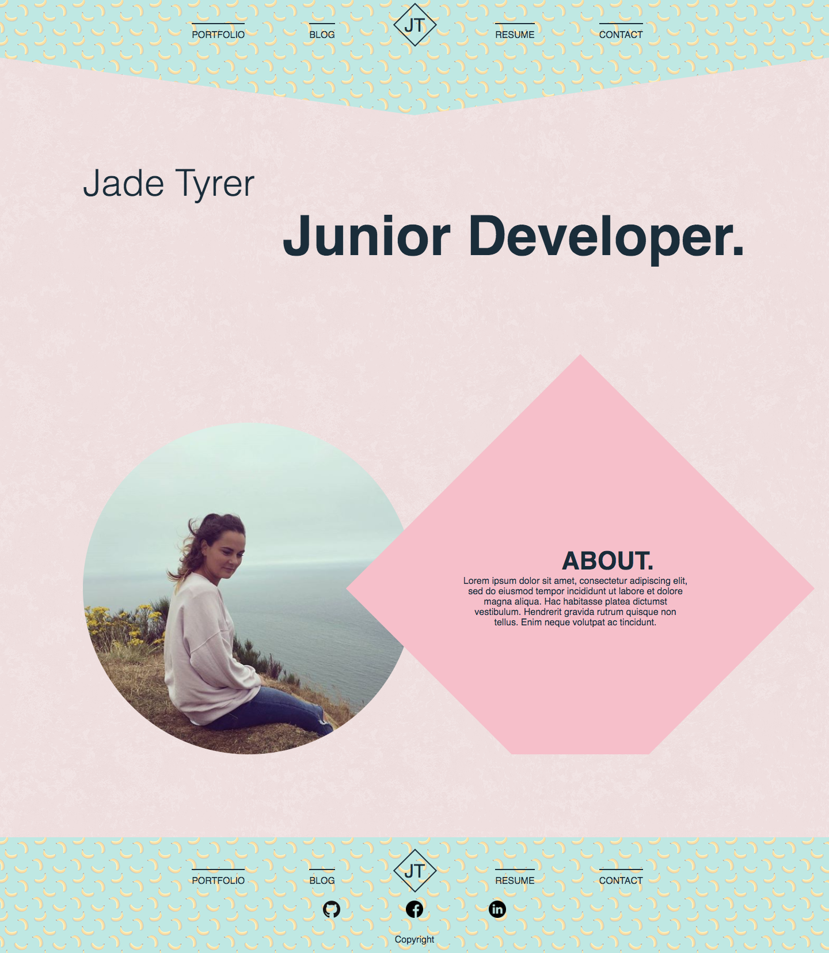
Alternative aesthetics.

Slide 11
Thank you.
Notes:
Show website
Favourite part is the nav bar and the logo as its different and makes my page stand out

